Slide 1
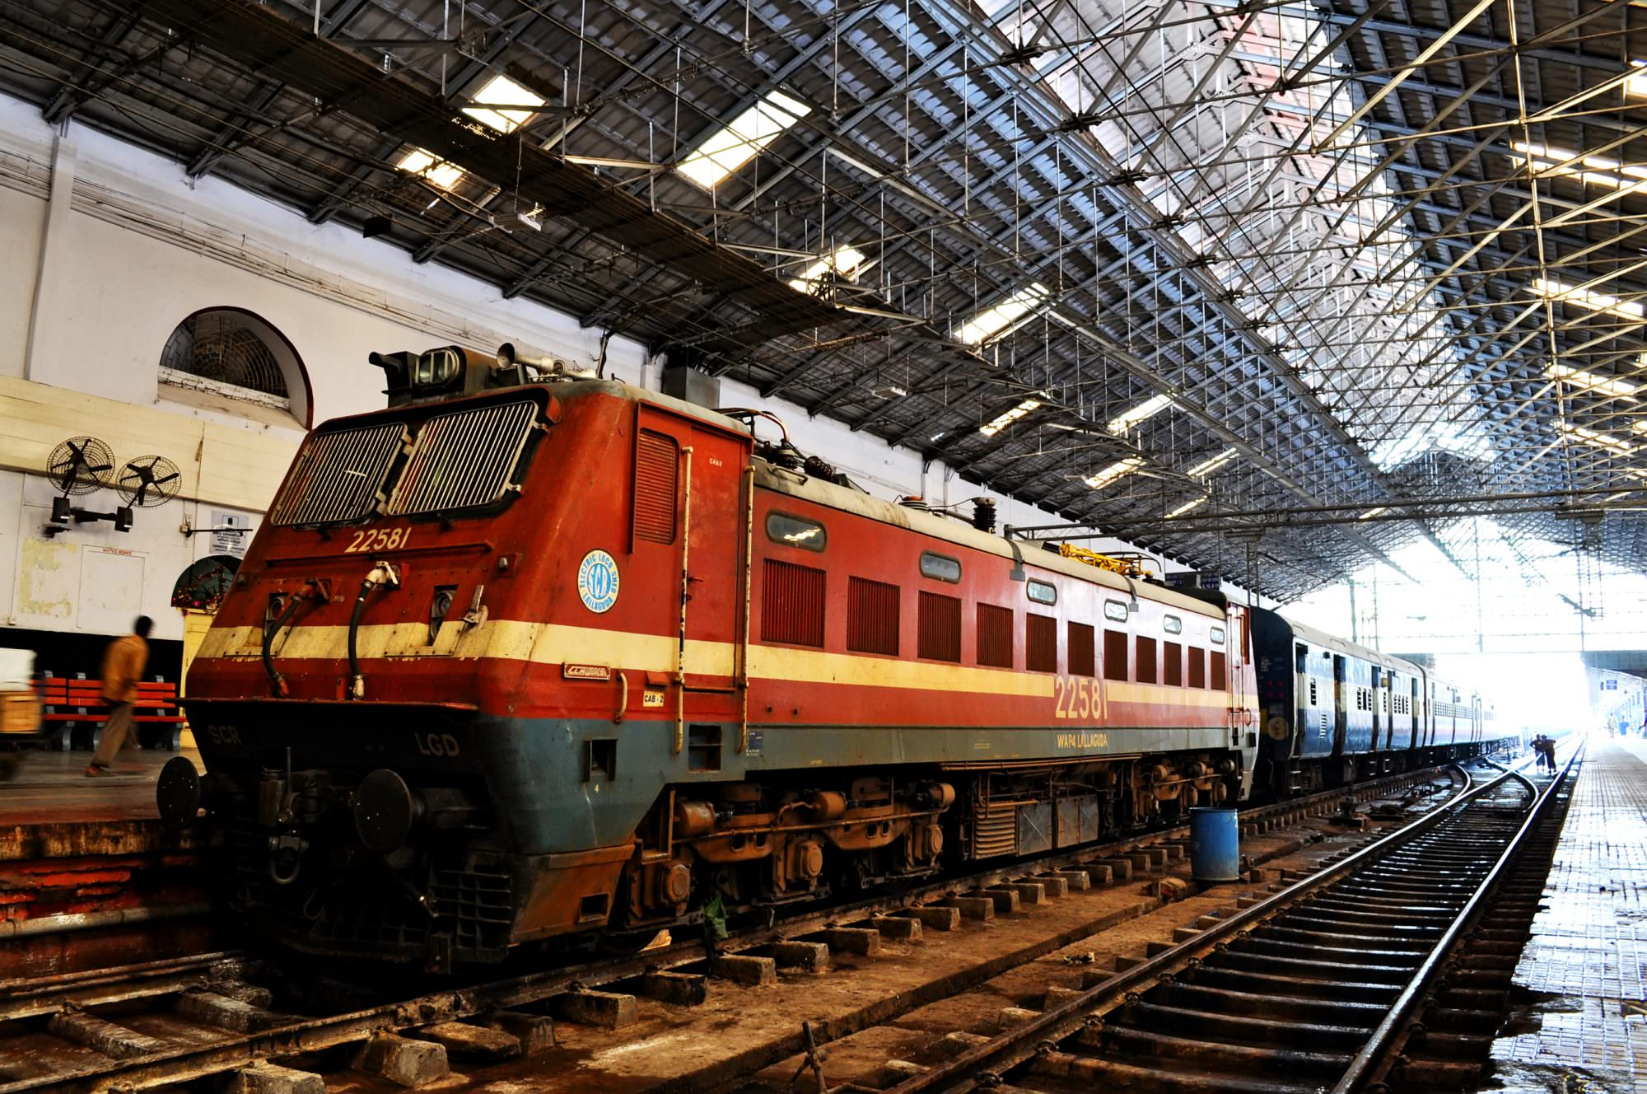
Indian Railways System Migration to AWS
Vinodh
Raghavendran
Nidhin
Himanshu Nimje

Slide 2
Introduction
The Indian Railways system is one of the largest rail networks in the world, spanning over 67,000 kilometers and connecting thousands of towns and cities across the country. It plays a crucial role in India's transportation infrastructure, carrying millions of passengers and tons of freight every day.
Now, in the context of AWS migration, Indian Railways could benefit from leveraging cloud services like Amazon Web Services (AWS) to address some of its challenges and modernize its operations
Scalability
Cost Efficiency
Data Analytics
Security and Compliance
Modernization

Slide 3
Why Migrate ?
1. Aging Infrastructure
2. Modernization Needs
3. Better Passenger Experience
4. Environmental Sustainability
5. Support Economic Development

Slide 4
Benefits of Migration
Advantages of Migrating Indian Railways System to AWS
Scalability
Reliability
Cost-effectiveness
Security
Flexibility
Innovation

Slide 5
Migration Steps
Migration Step typically involves planning and assessment to lay the groundwork for a successful migration of the Indian Railways system to Amazon Web Services (AWS).
Discovery and Inventory
Assessment and Planning
Setup AWS Environment
Data Migration
Application Migration
Testing and Validation
Optimization and Performance Tuning
Security and Compliance
Training and Knowledge Transfer
Go-Live and Post-Migration Support

Slide 6
AWS Services utilized for Migration
Overview of AWS Services for Migration:
Amazon EC2 (Elastic Compute Cloud)
Amazon RDS (Relational Database Service)
Amazon S3 (Simple Storage Service)
AWS Migration Hub
AWS Data Sync

Slide 7
Architecture Diagram
Three-Tier Architecture Model for IRS Migration to AWS:
• Application Tier: Utilizes Amazon EC2 instances for scalability, availability, security, and cost efficiency.
• Database Tier: Relies on Amazon RDS for scalability, availability, security, and cost efficiency.
• Storage Tier: Leverages Amazon S3 for scalability, availability, security, and cost efficiency

Slide 8
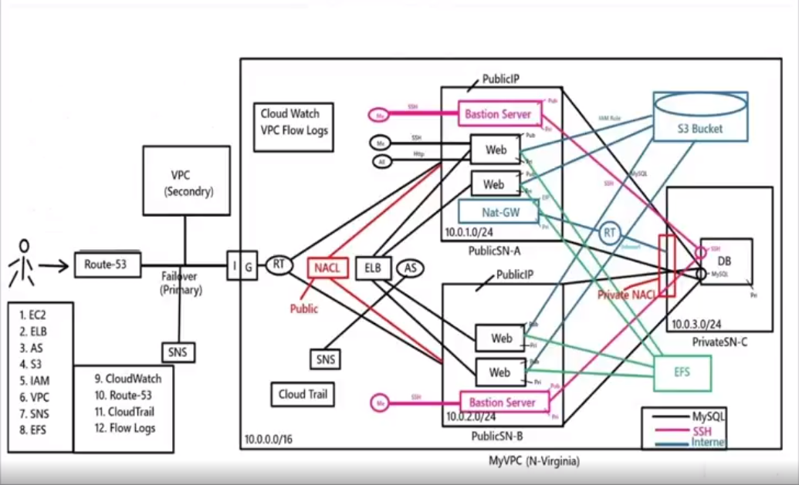
Architecture Diagram

Slide 9
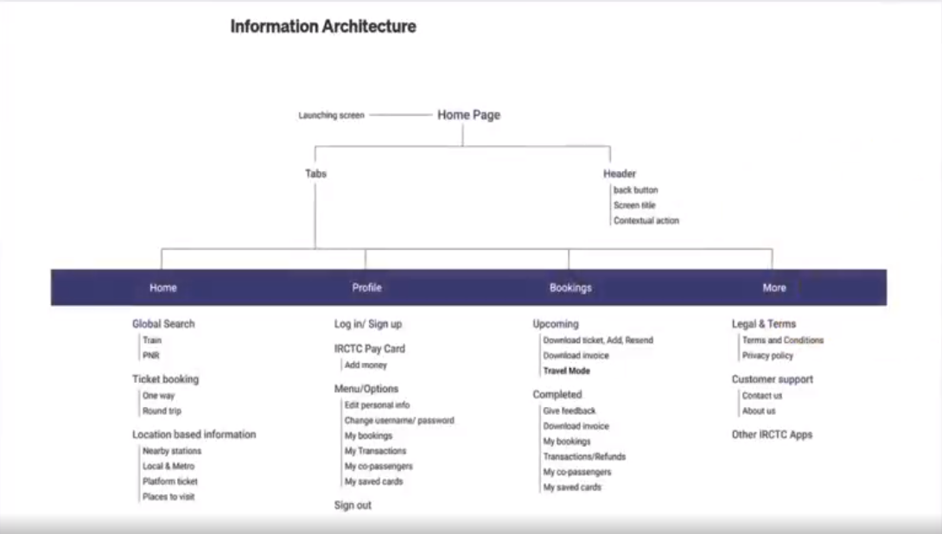
Site Map

Slide 10
Consumptions of IRS
Resource Consumption Overview:
During the migration of the Indian Railway System (IRS) to AWS, various resources are essential to support the transition and ongoing operations.
This section will provide insights into three crucial resource areas:
Bandwidth
Storage
processing requirements.

Slide 11
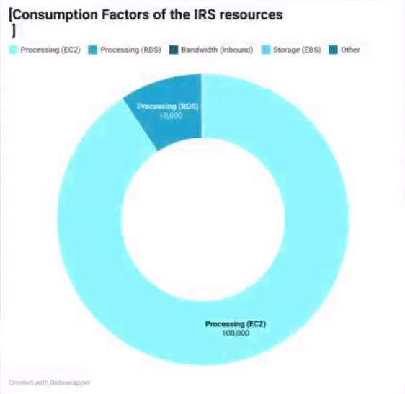
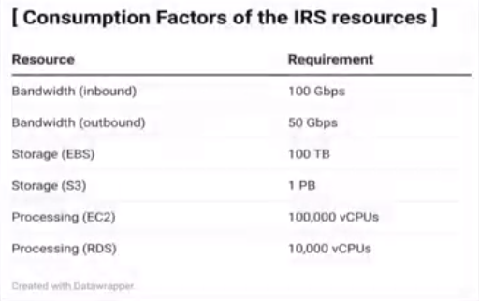
Consumptions of IRS
Resource Consumption Summary:
Current Consumption:
Bandwidth: 150 Gbps (Inbound: 100 Gbps, Outbound: 50 Gbps).
Storage: 1.1 PB (EBS: 100 TB, S3. 1 PB).
Processing: 110,000 CPUs (EC2: 100,000, RDS: 10,000).

Slide 12
Conclusion
The successful migration to AWS significantly enhances the Indian Railway System (IRS), resulting in improved performance, reduced operational costs, and a highly reliable transportation network for both passengers and freight. The implementation of robust security measures ensures the protection of sensitive data and operations, while cost-efficient AWS pricing options contribute to substantial overall savings.

Slide 13
Thankyou.

